Slide 1
AWS

Slide 2
Amazon VPC

Slide 3
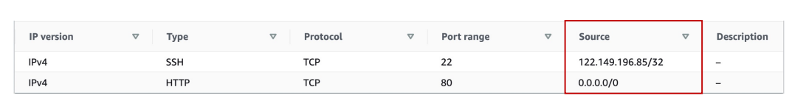
Understanding CIDR – IPv4
• Classless Inter-Domain Routing – a method for allocating IP addresses
• Used in Security Groups rules and AWS networking in general
They help to define an IP address range:
• We’ve seen WW.XX.YY.ZZ/32 => one IP
• We’ve seen 0.0.0.0/0 => all IPs
• But we can define:192.168.0.0/26 =>192.168.0.0 – 192.168.0.63 (64 IP
addresses)

Slide 4
Understanding CIDR – IPv4
• A CIDR consists of two components
• Base IP
• Represents an IP contained in the range (XX.XX.XX.XX)
• Example: 10.0.0.0, 192.168.0.0, …
• Subnet Mask
• Defines how many bits can change in the IP
• Example: /0, /24, /32
• Can take two forms:
• /8 = 255.0.0.0
• /16 = 255.255.0.0
• /24 = 255.255.255.0
• /32 z 255.255.255.255

Slide 5
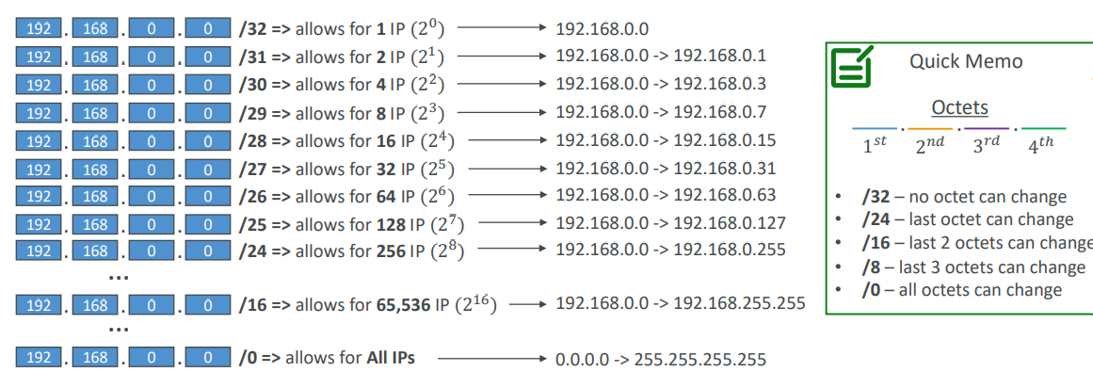
Understanding CIDR – Subnet Mask
• The Subnet Mask basically allows part of the underlying IP to get
additional next values from the base IP

Slide 6
Understanding CIDR – Little Exercise
• 192.168.0.0/24 = … ?
192.168.0.0 – 192.168.0.255 (256 IPs)
• 192.168.0.0/16 = … ?
192.168.0.0 – 192.168.255.255 (65,536 IPs)
• 134.56.78.123/32 = … ?
Just 134.56.78.123
• 0.0.0.0/0
All IPs!
• When in doubt, use this website https://www.ipaddressguide.com/cidr

Slide 7
Public vs. Private IP (IPv4)
• The Internet Assigned Numbers Authority (IANA) established certain
blocks of IPv4 addresses for the use of private (LAN) and public
(Internet) addresses
• Private IP can only allow certain values:
10.0.0.0 – 10.255.255.255 (10.0.0.0/8) ← in big networks
172.16.0.0 – 172.31.255.255 (172.16.0.0/12) ← AWS default VPC in that range
192.168.0.0 – 192.168.255.255 (192.168.0.0/16) ← e.g., home networks
• All the rest of the IP addresses on the Internet are Public

Slide 8
Default VPC Walkthrough
• All new AWS accounts have a default VPC
• New EC2 instances are launched into the default VPC if no subnet is
specified
• Default VPC has Internet connectivity and all EC2 instances inside it
have public IPv4 addresses
• We also get a public and a private IPv4 DNS names

Slide 9
VPC in AWS – IPv4
• VPC = Virtual Private Cloud
• You can have multiple VPCs in an AWS region (max. 5 per region – soft limit)
• Max. CIDR per VPC is 5, for each CIDR:
• Min. size is /28 (16 IP addresses)
• Max. size is /16 (65536 IP addresses)
• Because VPC is private, only the Private IPv4 ranges are allowed:
• 10.0.0.0 – 10.255.255.255 (10.0.0.0/8)
• 172.16.0.0 – 172.31.255.255 (172.16.0.0/12)
• 192.168.0.0 – 192.168.255.255 (192.168.0.0/16)
• Your VPC CIDR should NOT overlap with your other networks (e.g., corporate)

Slide 10
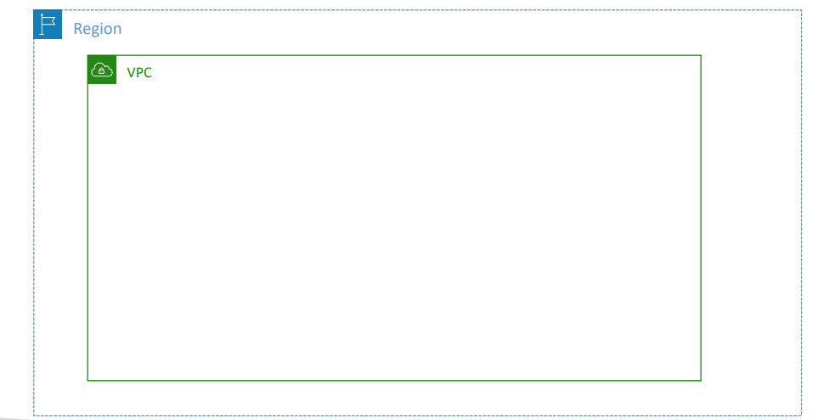
Hands -on

Slide 11
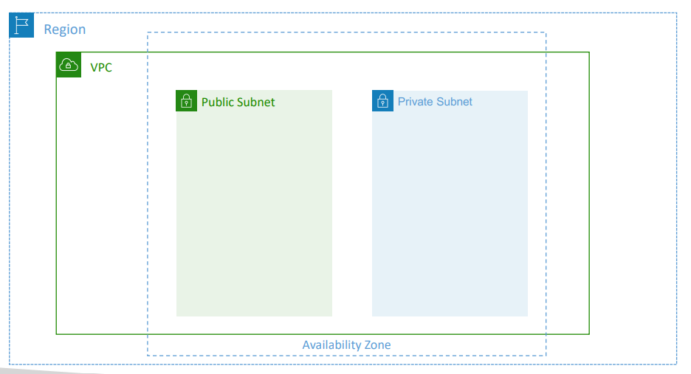
Adding Subnets

Slide 12
VPC – Subnet (IPv4)
• AWS reserves 5 IP addresses (first 4 & last 1) in each subnet
• These 5 IP addresses are not available for use and can’t be assigned to an
EC2 instance
• Example: if CIDR block 10.0.0.0/24, then reserved IP addresses are:
10.0.0.0 – Network Address
10.0.0.1 – reserved by AWS for the VPC router
10.0.0.2 – reserved by AWS for mapping to Amazon-provided DNS
10.0.0.3 – reserved by AWS for future use
10.0.0.255 – Network Broadcast Address. AWS does not support broadcast in a VPC, therefore the address is reserved

Slide 13
Internet Gateway (IGW)
• Allows resources (e.g., EC2 instances) in a VPC connect to the Internet
• It scales horizontally and is highly available and redundant
• Must be created separately from a VPC
• One VPC can only be attached to one IGW and vice versa
• Internet Gateways on their own do not allow Internet access…
• Route tables must also be edited!

Slide 14
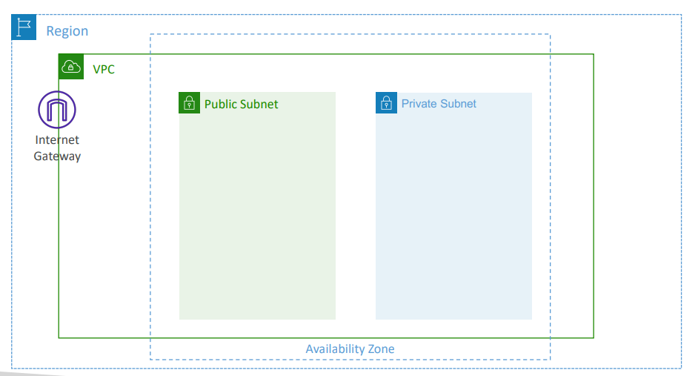
Adding Internet Gateway

Slide 15
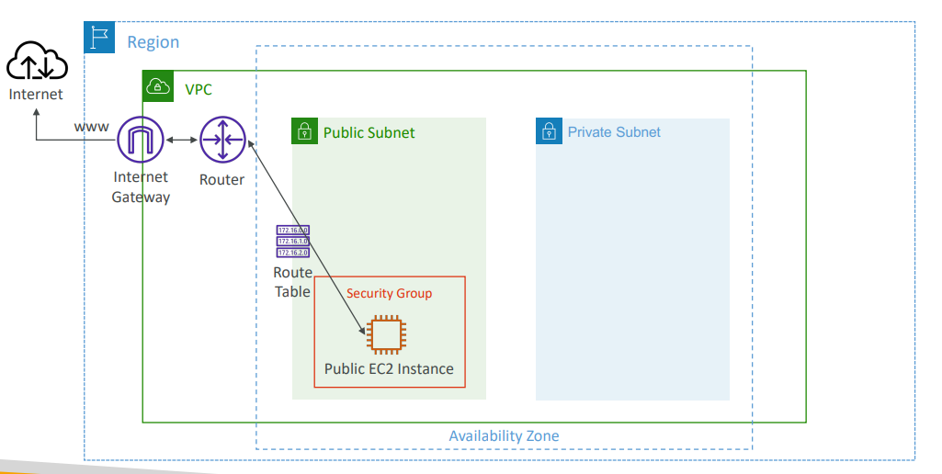
Editing Route Tables

Slide 16
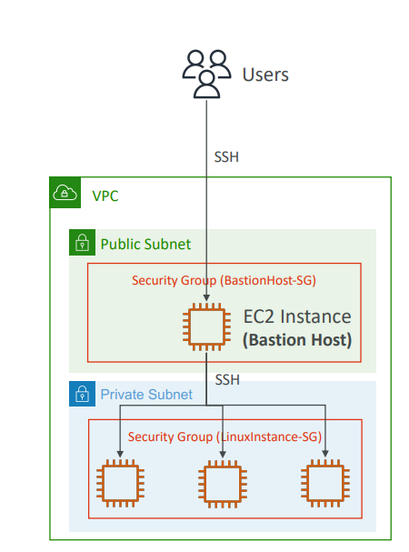
Bastion Hosts
• We can use a Bastion Host to SSH into
our private EC2 instances
• The bastion is in the public subnet which is
then connected to all other private subnets
• Bastion Host security group must allow
inbound from the internet on port 22 from
restricted CIDR, for example the public
CIDR of your corporation
• Security Group of the EC2 Instances must
allow the Security Group of the Bastion
Host, or the private IP of the Bastion host

Slide 17
NAT Gateway
• AWS-managed NAT, higher bandwidth, high availability, no administration
• Pay per hour for usage and bandwidth
• NATGW is created in a specific Availability Zone, uses an Elastic IP
• Can’t be used by EC2 instance in the same subnet (only from other
subnets)
• Requires an IGW (Private Subnet => NATGW => IGW)
• 5 Gbps of bandwidth with automatic scaling up to 100 Gbps
• No Security Groups to manage / required

Slide 18
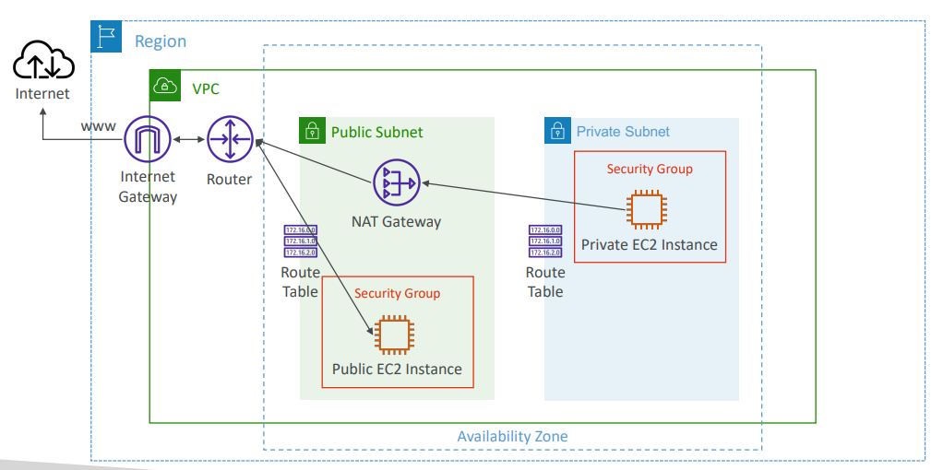
NAT Gateway

Slide 19
Network Access Control List (NACL)
• NACL are like a firewall which control traffic from and to subnets
• One NACL per subnet, new subnets are assigned the Default NACL
• You define NACL Rules:
Rules have a number (1-32766), higher precedence with a lower number
First rule match will drive the decision
Example: if you define #100 ALLOW 10.0.0.10/32 and #200 DENY 10.0.0.10/32, the IP
address will be allowed because 100 has a higher precedence over 200
The last rule is an asterisk (*) and denies a request in case of no rule match
AWS recommends adding rules by increment of 100
• Newly created NACLs will deny everything
• NACL are a great way of blocking a specific IP address at the subnet level

Slide 20
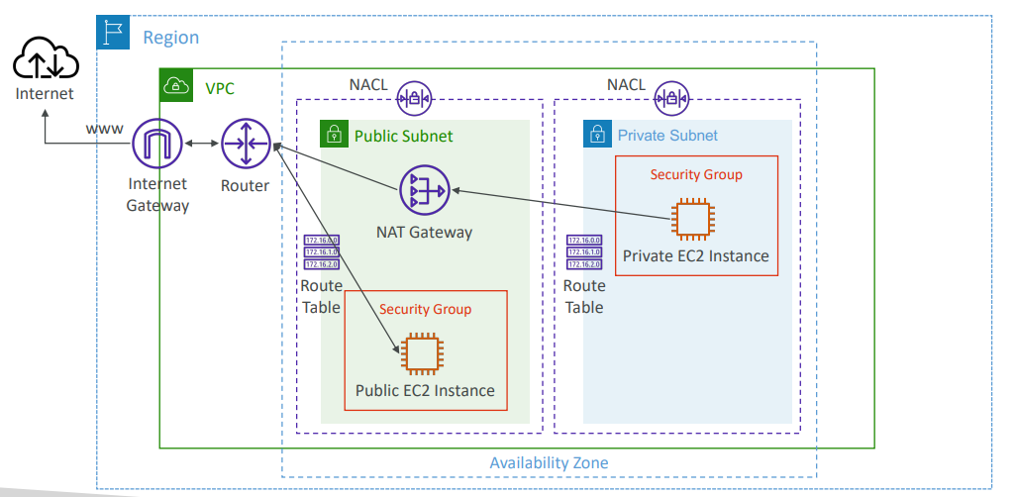
NACLs

Slide 21
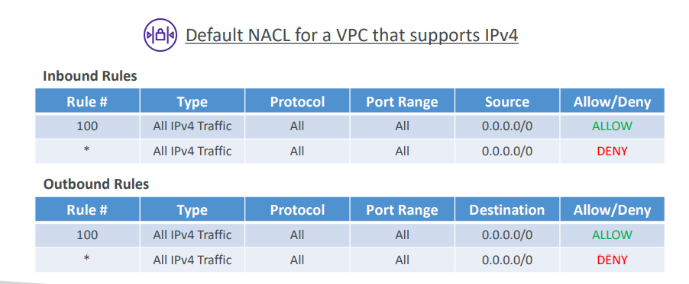
Default NACL
• Accepts everything inbound/outbound with the subnets it’s associated with
• Do NOT modify the Default NACL, instead create custom NACLs

Slide 22
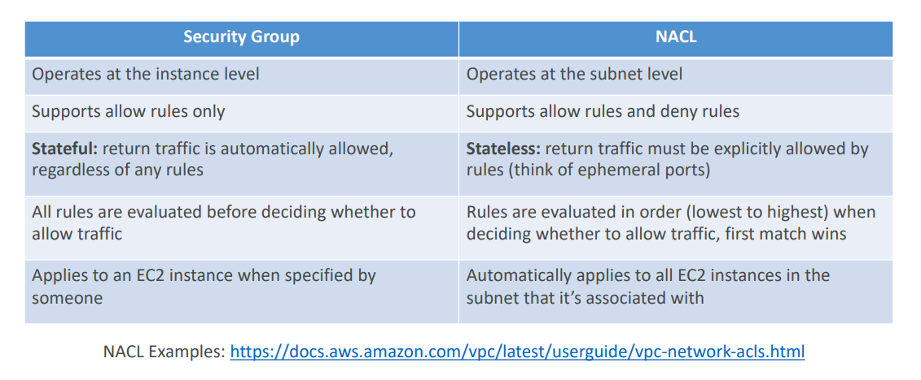
Security Group vs. NACLs

Slide 23
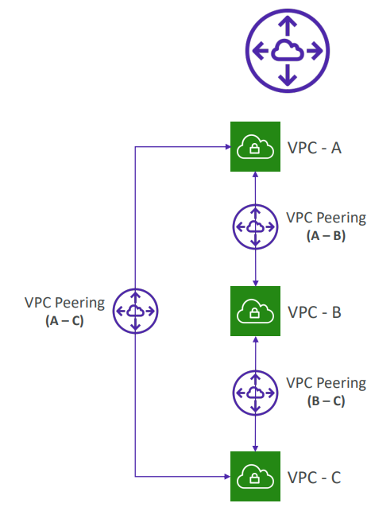
VPC Peering
• Connect two VPC, privately using
AWS’ network
• Make them behave as if they were
in the same network
• Must not have overlapping CIDR (IP
address range)
• VPC Peering connection is not
transitive (must be established for
each VPC that need to
communicate with one another)

Slide 24
Summary
• VPC – Virtual Private Cloud
• Subnets – Tied to an AZ, network partition of the VPC
• Internet Gateway – at the VPC level, provide Internet Access
• NAT Gateway / Instances – give internet access to private subnets
• NACL – Stateless, subnet rules for inbound and outbound
• Security Groups – Stateful, operate at the EC2 instance level or ENI
• VPC Peering – Connect two VPC with non overlapping IP ranges, nontransitive
• Elastic IP –fixed public IPv4, ongoing cost if not in-use

